Slide 1

A Short Tour of Machine Learning
Michael Mathioudakis
Covve, Athens, 2017-08-02

Slide 2
today
part 1: machine-learning algorithms
basic concepts and the ML pipeline
algorithms
part 2: platforms and software
part 3: hands-on session

Slide 3
part 1: machine learning algorithms

Slide 4
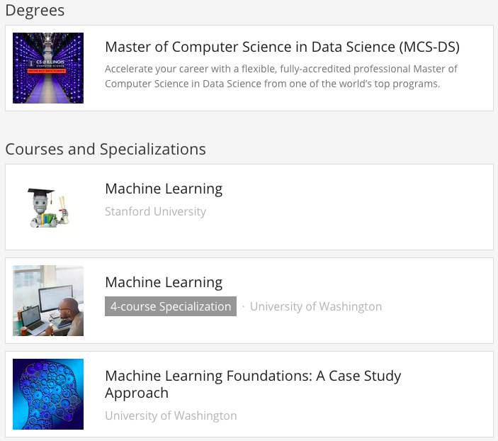
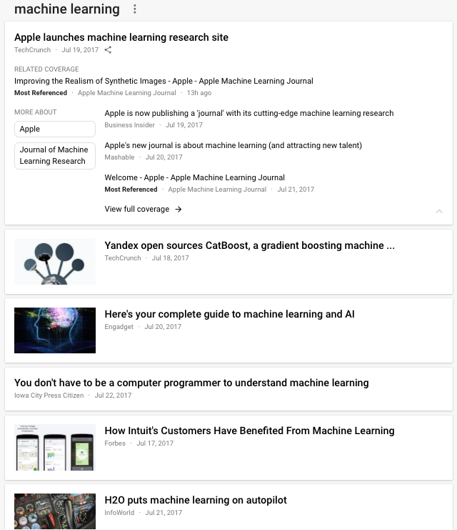
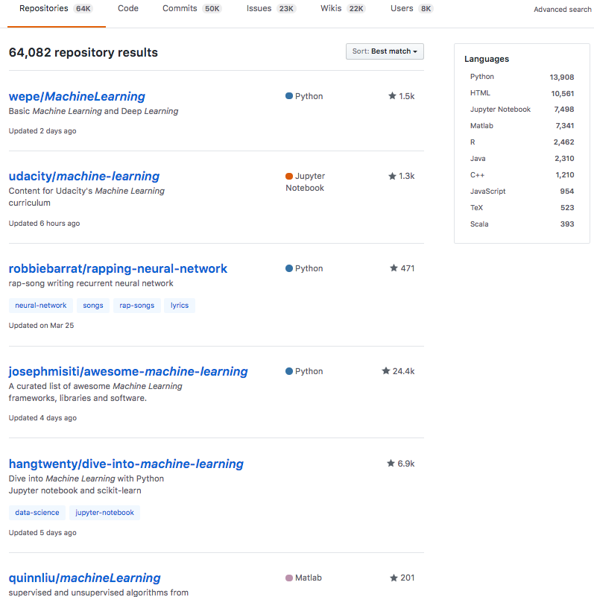
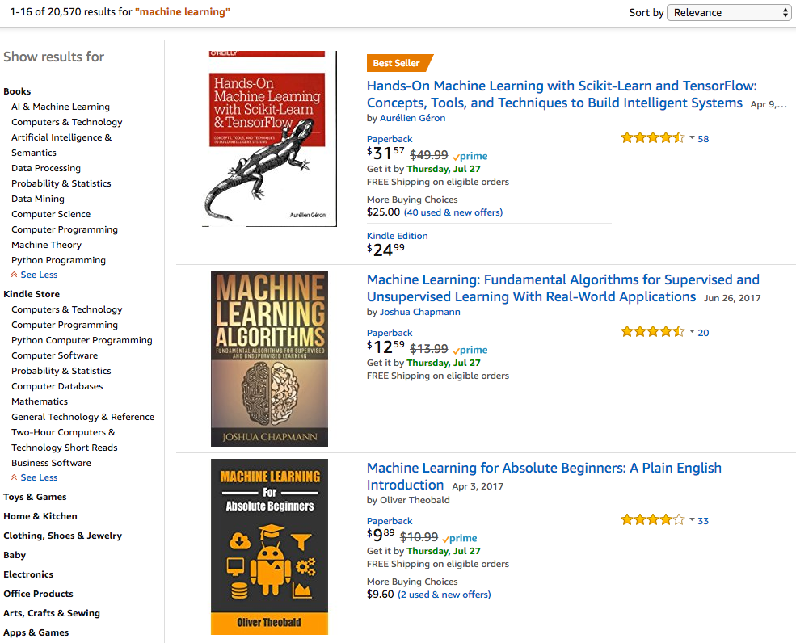
Notes:
Machine learning…
... in the news, amazon books, universities and online courses, software.

Slide 5
what is machine learning?

Slide 6
‘learning’
what do we learn?
a description of the data
a ‘model’ that tells us how the data are distributed
why?
to make predictions and decisions

Slide 7
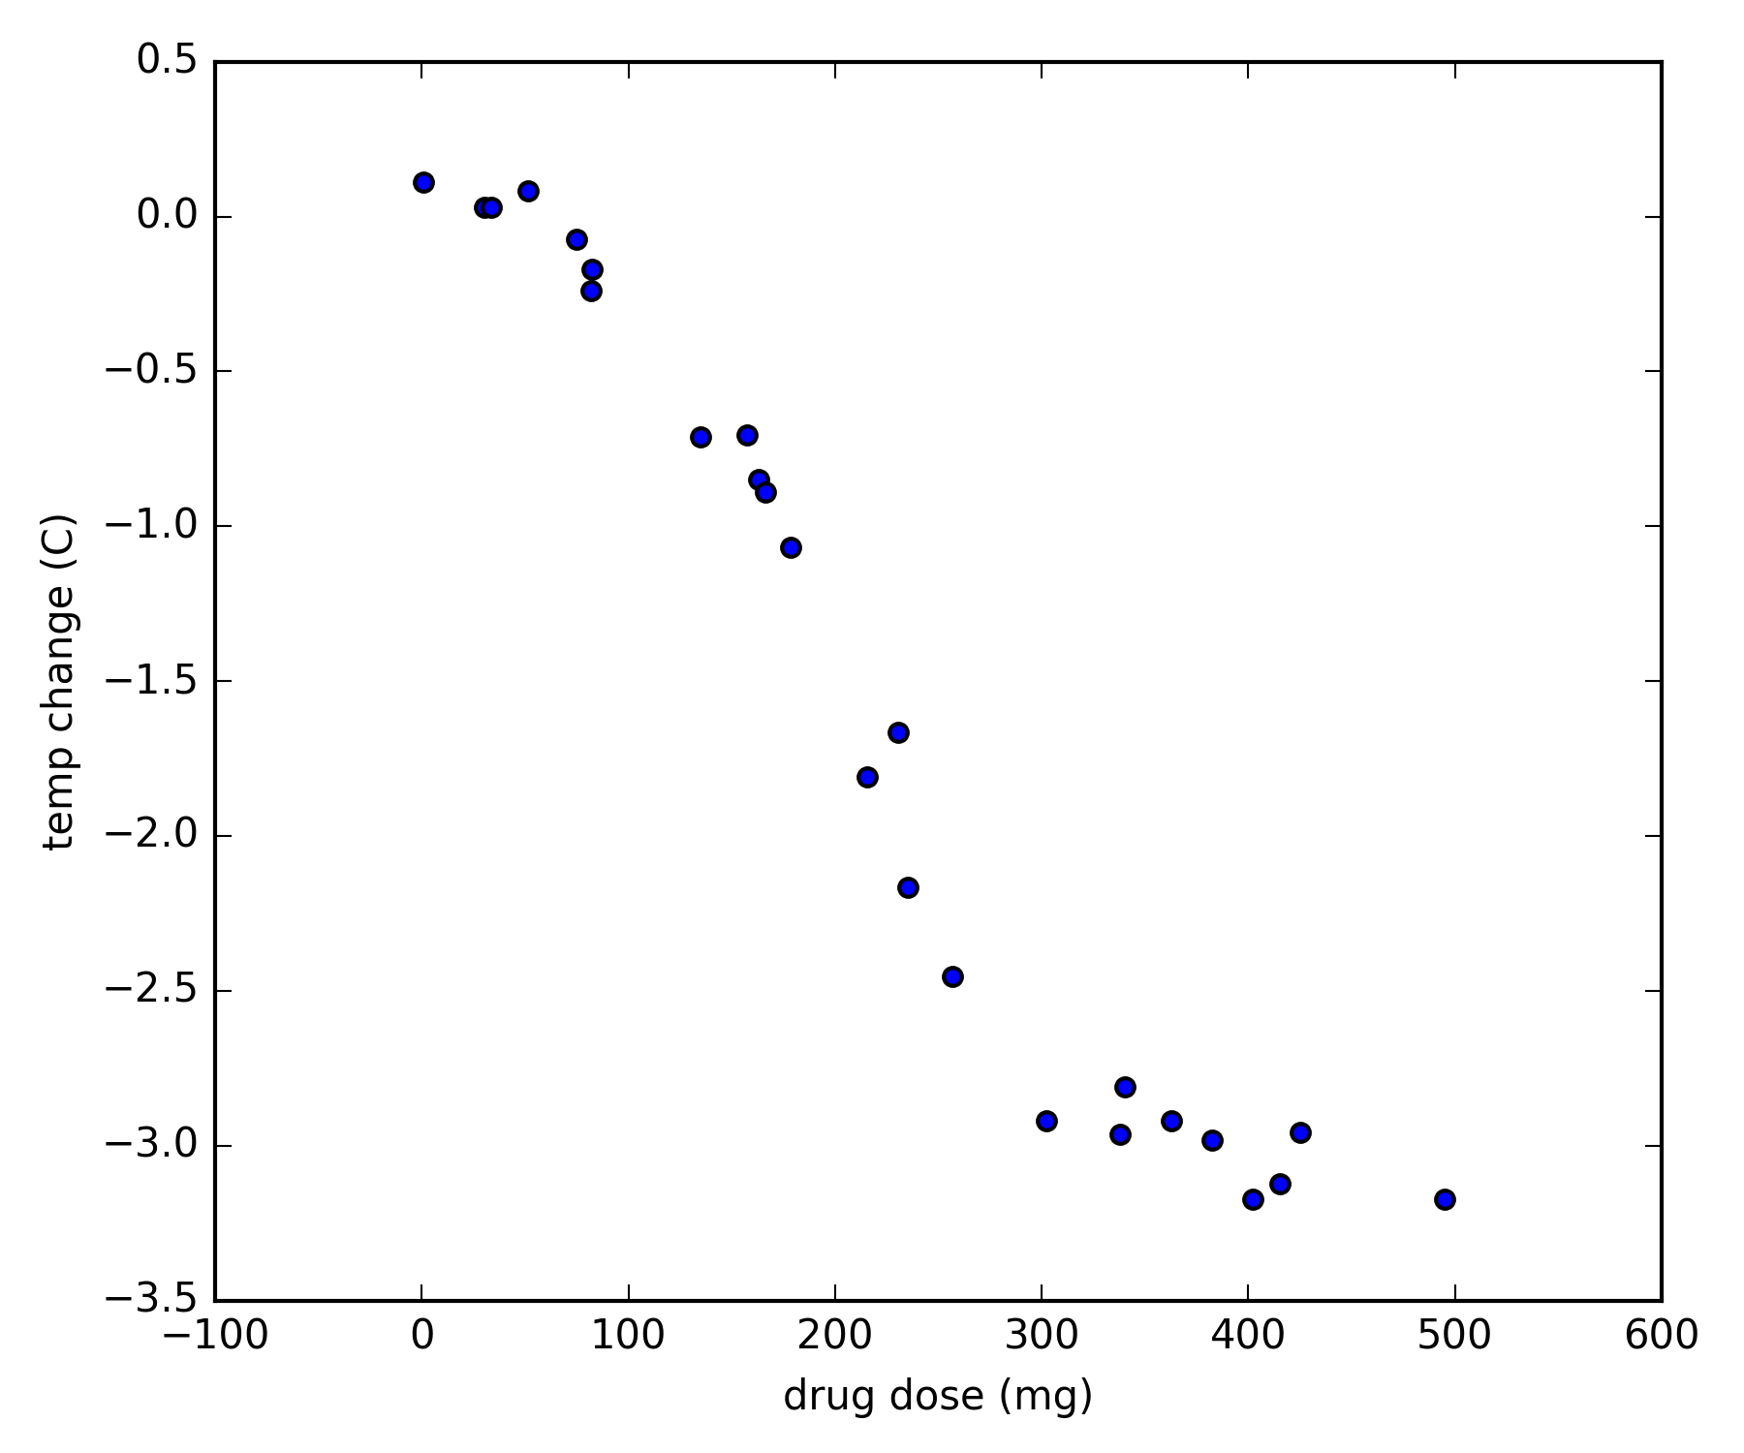
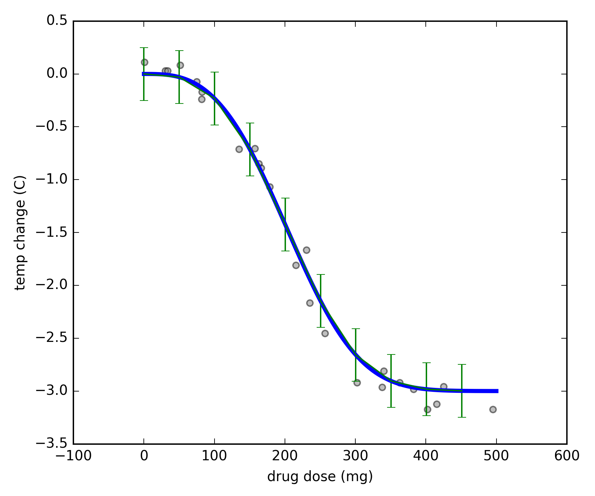
example
the patient’s temperature has just exceeded 40C
we supply a drug and observe their temperature change after 2 hours
learning
model
data
ok, we ‘learned’ - then what?
predict what happens to temperature if we supply 0.20mg?
decide minimum dose to achieve at least 2.5C temp drop?
can do with the model
without the data

Slide 8
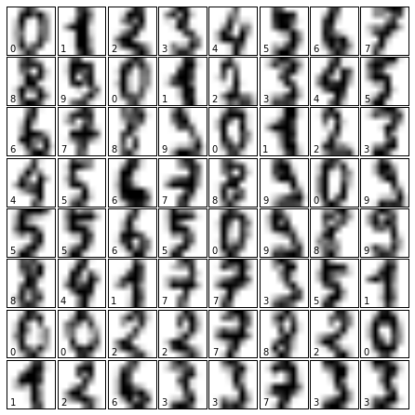
example
digit recognition
classification

Slide 9
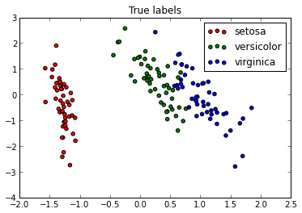
example
clustering
density estimation
Y
X

Slide 10
‘machine’ learning
why do we need the machines?
to make learning
automated
and
efficient
big data
complex models

Slide 11

example: language
task: complete the sentence
language is complex
basic rules (syntax and grammar)
do not suffice for good predictions
requires complex models
data
millions/billions of sentences/queries
user features
session attributes

Slide 12
ML pipeline
learning
inference / training / fitting
data
model
prediction
decision
model candidates
probability
how much we believe that something is true

Slide 13
outline
what is machine learning
examples of tasks: regression, classification, clustering
data, learning, prediction, decision; probability
probability
algorithms
regression
classification
clustering
deep learning

Slide 14
probability
‘proposition’
how much we believe that something is true
GIVEN some information
VERY IMPORTANT!
0: impossible 1: certain

Slide 15
probability
a ball drops out of the box
it is green

Slide 16
probability
this shape is ‘1’

Slide 17
ML pipeline
learning
data
model
prediction
decision
model candidates
probability
assign probabilities to propositions

Slide 18
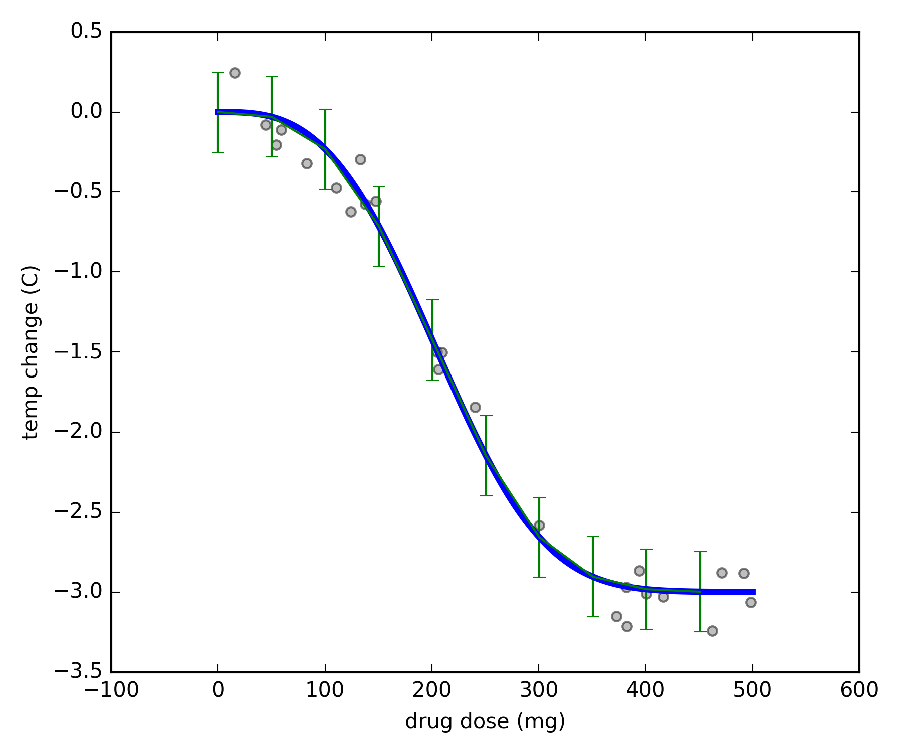
probability :: prediction
what is the probability that a dose of 300mg drops temperature more than 2C ?
probability of
temp. drop > 2C
given
dose = 300 mg and model (see figure)
proposition
P(temp. drop > 2C | dose = 300 mg ; model)
given information
the value for this probability is provided by the model!

Slide 19
ML pipeline
learning
data
model
prediction
decision
model candidates
probability
assign probabilities to models

Slide 20
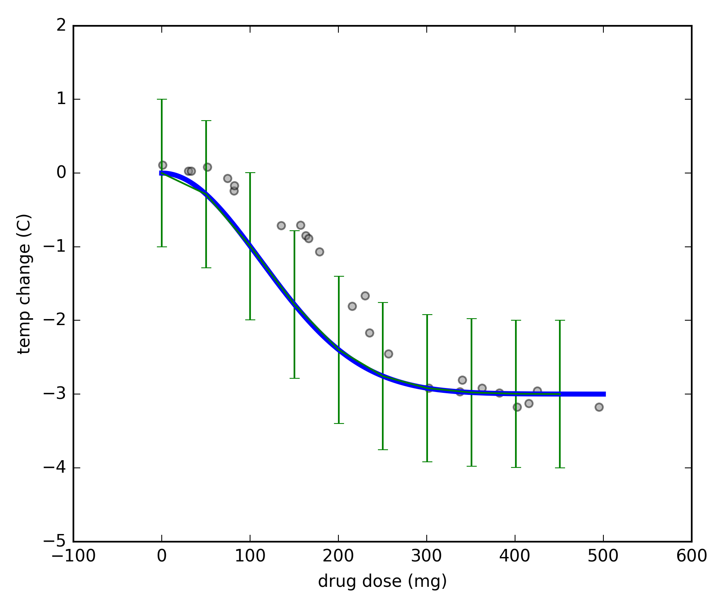
probability :: learning
consider models where temperature drops
exponentially with dose
drop : dose^{-k} and error up to ε
what is the probability that the right model is M1 / M2 / … ?
model M1
probability of
model (k, ε)
given
data
k from -5 to + 5 and ε from -2 to +2
model M2

Slide 21
probability :: learning
p ( model (k, ε) | data; k in [-5, + 5], ε in [-2, +2] )
p ( M | D ; I )
from Bayes’ Rule, this is proportional to
p(data | M ; I) x p(M | I)
model M1
likelihood
prior
we choose the model of maximum probability
(do we have to?)
model M2

Slide 22
ML pipeline
learning
data
model
prediction
decision
model candidates
probability

Slide 23
ML pipeline – the Bayesian way
learning
data
prediction
decision
model candidates
probability

Slide 24
in what follows…
learning
data
model
prediction
decision
model candidates

Slide 25
outline
what is machine learning
examples of tasks: regression, classification, clustering
data, learning, prediction, decision; probability
probability
algorithms
regression
classification
clustering
deep learning

Slide 26
regression
build model that provides
dp(Y = y | X = x; Model M)
for real-valued Y
regression methods differ in the set of model candidates
they consider
each method has corresponding algorithm(s)
to search for best model
Y
X

Slide 27
some regression methods
linear regression
line + error
segmented regression
k segments + errors
multinomial regression
curve + error
this is where methods differ
p ( M | data ; I ) ∝ p(data | M ; I) x p(M | I)
each model comes with its own

Slide 28
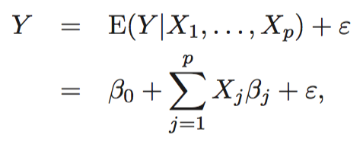
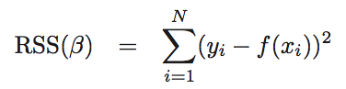
linear regression
solved with linear algebra if the data points are more than the dimensions

Slide 29
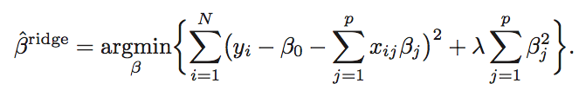
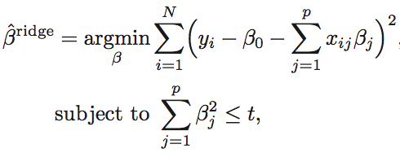
ridge regression
ridge regression

Slide 30
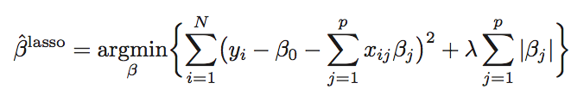
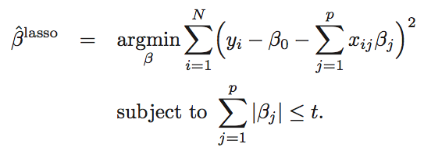
lasso

Slide 31
linear regression with shrinkage
the penalty on the size of β expresses a prior

Slide 32
decision trees
predict the value of the leaf
build tree to minimize error
(e.g., square error)
subject to restrictions
gender = male?
age > 50?
age < 25?
weight = 80
age < 25?
weight = 60
weight = 40
weight = 70
weight = 50

Slide 33
random forests
build many decision trees on
random subset of data
random subset of features
combine predictions
gender = male?
age > 50?
age < 25?
weight = 80
age < 25?
weight = 60
weight = 40
weight = 70
weight = 50

Slide 34
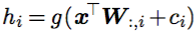
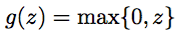
neural networks
idea
apply a linear model on a non-linear transformation of the input

Slide 35
outline
what is machine learning
examples of tasks: regression, classification, clustering
data, learning, prediction, decision; probability
probability
algorithms
regression
classification
clustering
deep learning

Slide 36
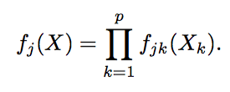
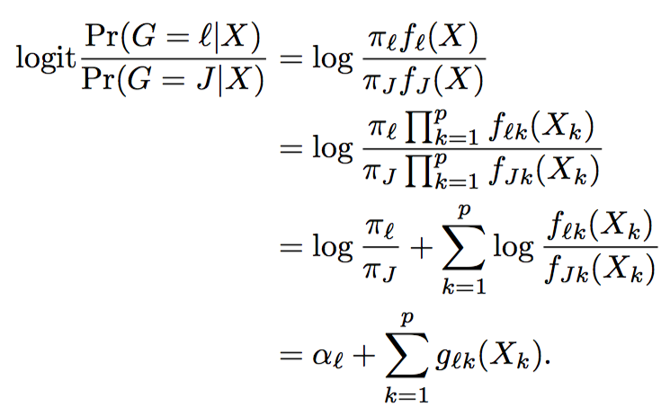
naïve-bayes
within each class, features are distributed independently
p(X | C = j) =

Slide 37
classification
build model that provides
p(Y = y | X = x; Model M)
for categorically-valued Y
classification methods differ in the set of model candidates
they consider
each method has corresponding algorithm(s)
to search for best model
what is X and Y for digit recognition?

Slide 38
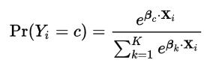
logistic regression

Slide 39
decision trees & random forests
very similar to regression methods
leafs assign probabilities to classes

Slide 40
neural networks
idea
apply a linear model on a non-linear transformation of the input
evidence for one class

Slide 41
support-vector machines
separate the classes
with hyperplanes

Slide 42
outline
what is machine learning
examples of tasks: regression, classification, clustering
data, learning, prediction, decision; probability
probability
algorithms
regression
classification
clustering
deep learning

Slide 43
supervised and unsupervised learning
the methods we saw for
regression and classification
are cases of ‘supervised’ learning
build model that provides
p(Y = y | X = x; Model M)
other data features
some data features
build model that provides
p(X = x, Y = y; Model M)
‘unsupervised’ learning

Slide 44
unsupervised learning
build model that provides
p(X = x, Y = y; Model M)
find structure in the data
Y
X

Slide 45
k-means clustering
clustering
assign points to clusters
so that total distance from cluster center is minimized
k-means
assign points to cluster of nearest center
compute centers from assigned points
repeat
Y
X

Slide 46
PCA
project the data on orthogonal system
so that successive dimensions maximize remaining variance

Slide 47
outline
what is machine learning
examples of tasks: regression, classification, clustering
data, learning, prediction, decision; probability
probability
algorithms
regression
classification
clustering
deep learning

Slide 48
deep learning
basically another name for ‘neural networks’
with many layers
and generalized structure
rebranded due to
efficiency and good results on difficult tasks
language (translation, sentence completion)
image recognition

Slide 49
recurrent neural networks

Slide 50
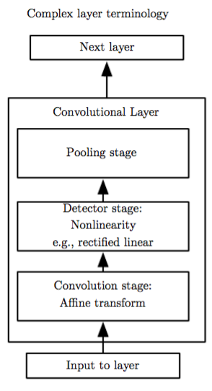
convolutional neural networks

Slide 51
convolutional neural networks

Slide 52
part 2: platforms and software

Slide 53
outline
scikit-learn
deep-learning libraries
ML on the cloud
amazon, azure, google
apache spark

Slide 54
scikit-learn
python ML library
on top of scipy stack
many general ML algorithms
standardized pipeline
ideal for fast prototyping
on moderate datasets

Slide 55
deep learning :: tensorflow
deep learning library
uses computation graphs

Slide 56
deep learning :: other
torch.ch
open source machine learning library
scientific framework, programming language (Lua)
used by Facebook Research
theano
http://deeplearning.net/software/theano/
deep learning with efficient numerical operations
microsoft cognitive toolkit (cntk)
https://cntk.ai/
tensorflow alternative
keras
simpler tensorflow, theano, cntk in python

Slide 57

cloud :: google
Cloud ML Engine
basically offers the ML pipeline
with Deep Learning models
as implemented in Tensorflow
other services
trained models for other applications
speech, video or image tagging, translation
https://cloud.google.com/products/machine-learning/
pricing: about 0.5$ per hour
Notes:
https://cloud.google.com/ml-engine/
https://research.googleblog.com/2016/06/wide-deep-learning-better-together-with.html
https://cloud.google.com/speech/

Slide 58
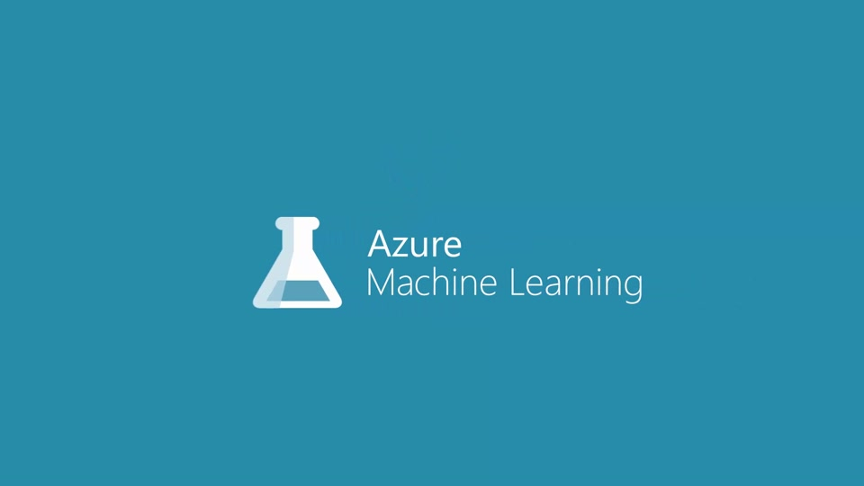
cloud :: other
amazon aws
classification and regression
with logistic and linear regression
microsoft azure
‘cortana intelligence’
ML pipeline
Notes:
http://docs.aws.amazon.com/machine-learning/latest/dg/types-of-ml-models.html

Slide 59

apache spark
machine learning algorithms
on top of Spark
iterative optimization

Slide 60
part 3: hands-on session

Slide 61
outline
scikit-learn
tensorflow

Slide 62
scikit-learn
http://scikit-learn.org/

Slide 63
tensorflow
https://www.tensorflow.org/

Slide 64
the end…

Slide 65
ML pipeline
learning
data
model
prediction
decision
model candidates
probability

